Slide 1
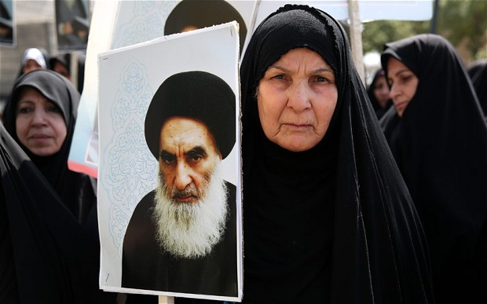
Women and The Big Four
(Well, really only three)
Sofia Smith

Slide 2
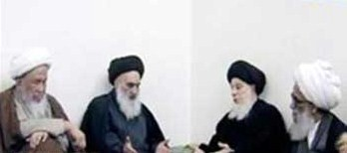
Who are Maraji?
Religious knowledge: Sources of emulation
Political power: “Most influential man in Iraq”
Closet feminists?: Reintegration of ISIS survivors, women’s votes, safety for women at protests

Slide 3
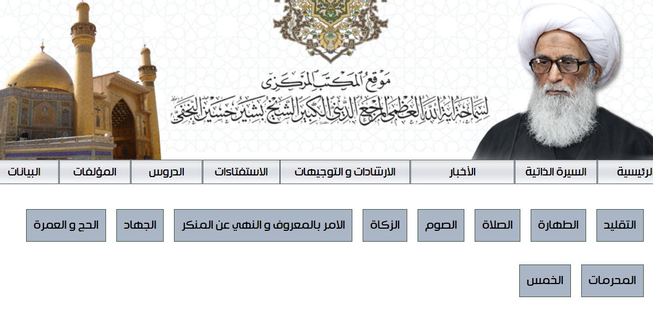
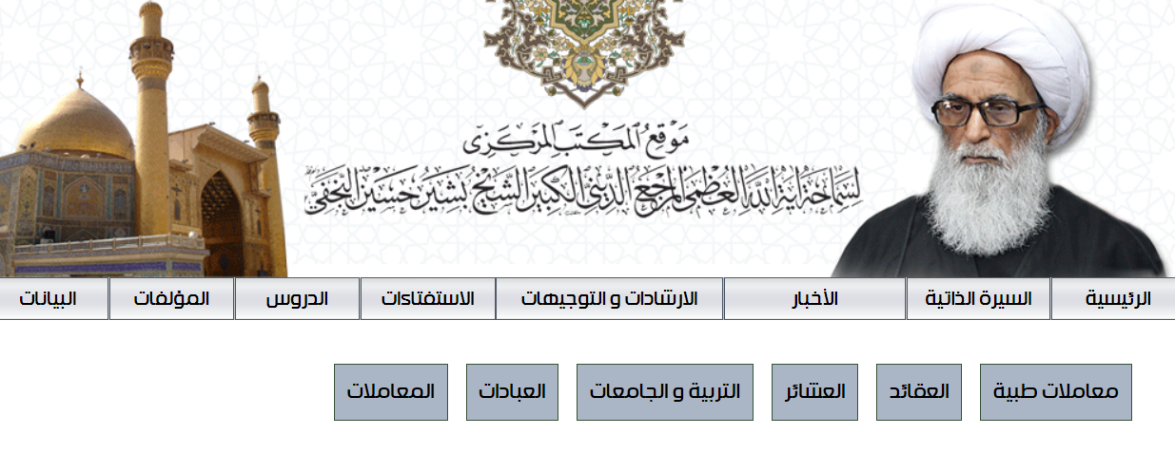
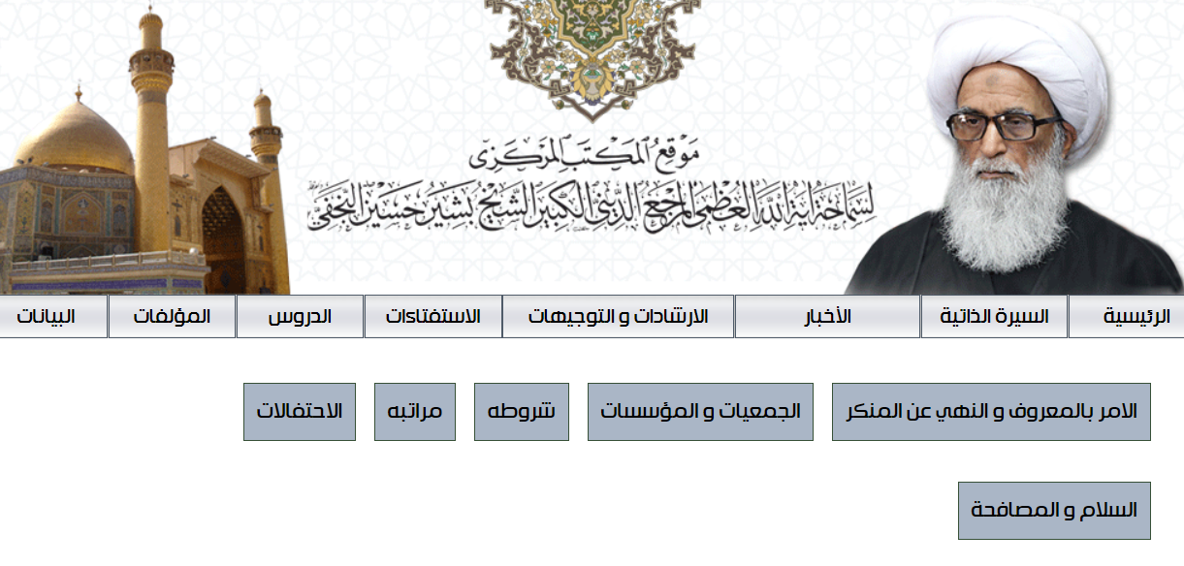
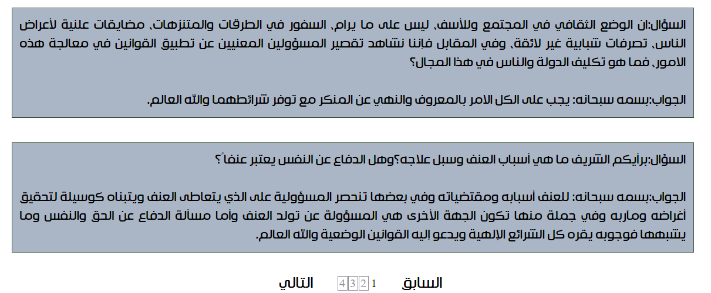
Web Scraping and the Iraqi Internet

Slide 4
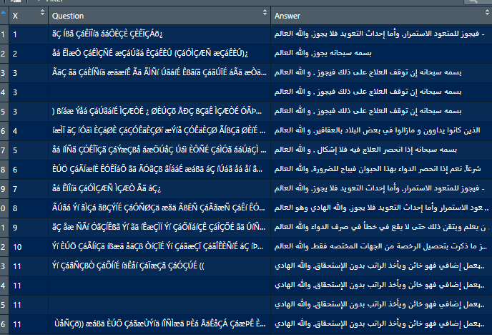
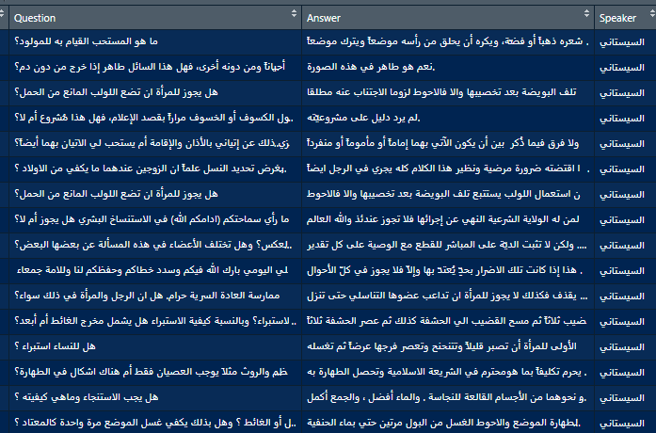
Sys.setlocale("LC_CTYPE", "arabic" ) : A Love Story

Slide 5
Words to Live By, Ayatollah Sistani
Question: Can I lie to my future husband about my past?
Answer: It is not permissible to tell him what is not true, it is not obligatory to inform him about all your past, and one should not expose their sins and secrets to anyone.

